Slide 1
Predicate Decision Diagrams for Explainable Policy Representation
Debraj Chakraborty ^{[1]} Clemens Dubslaff ^{[2]} Sudeep Kanav ^{[1]}
Jan Křetínský ^{[1]} Christoph Weinhuber ^{[3]}
[1] Masaryk University, Brno, Czechia
[2] Eindhoven University of Technology, Netherlands
[3] Technical University of Munich, Germany
LiVe 2024 @ ETAPS

Slide 2
Running Example
 | 🌳 | 🌳 | 🌳 | 🌳 | 🌳 | 🌳 | 🌳 | 🌳 | 🌳 | 🌳
 | 🌳 | 🐍 |  | 🌳 |  |  |  |  |  | 🌳
 | 🌳 |  |  | 🌳 |  |  |  | 🌳 | 🌳 | 🌳
 | 🌳 |  |  | 🌳 | 🌳 | 🌳 |  |  |  | 🌳
 | 🌳 |  |  |  |  |  |  |  |  | 🌳
 | 🌳 |  |  |  |  |  |  |  | 🍎 | 🌳
 | 🌳 | 🍎 |  |  |  | 🌳 | 🌳 | 🍎 |  | 🌳
 | 🌳 |  |  |  | 🌳 | 🌳 |  |  |  | 🌳
 | 🌳 |  |  |  |  |  |  |  |  | 🌳
 | 🌳 | 🌳 | 🌳 | 🌳 | 🌳 | 🌳 | 🌳 | 🌳 | 🌳 | 🌳

Slide 3
Controller
 | 🌳 | 🌳 | 🌳 | 🌳 | 🌳 | 🌳 | 🌳 | 🌳 | 🌳 | 🌳
 | 🌳 | 🐍 |  | 🌳 |  |  |  |  |  | 🌳
 | 🌳 |  |  | 🌳 |  |  |  | 🌳 | 🌳 | 🌳
 | 🌳 |  |  | 🌳 | 🌳 | 🌳 |  |  |  | 🌳
 | 🌳 |  |  |  |  |  |  |  |  | 🌳
 | 🌳 |  |  |  |  |  |  |  | 🍎 | 🌳
 | 🌳 | 🍎 |  |  |  | 🌳 | 🌳 | 🍎 |  | 🌳
 | 🌳 |  |  |  | 🌳 | 🌳 |  |  |  | 🌳
 | 🌳 |  |  |  |  |  |  |  |  | 🌳
 | 🌳 | 🌳 | 🌳 | 🌳 | 🌳 | 🌳 | 🌳 | 🌳 | 🌳 | 🌳
Action
State
System
Controller

Slide 4
Controller
x
 | 0 | 1 | 2 | 3 | 4 | 5 | 6 | 7 | 8 | 9
0 | 🌳 | 🌳 | 🌳 | 🌳 | 🌳 | 🌳 | 🌳 | 🌳 | 🌳 | 🌳
1 | 🌳 | 🐍 |  | 🌳 |  |  |  |  |  | 🌳
2 | 🌳 |  |  | 🌳 |  |  |  | 🌳 | 🌳 | 🌳
3 | 🌳 |  |  | 🌳 | 🌳 | 🌳 |  |  |  | 🌳
4 | 🌳 |  |  |  |  |  |  |  |  | 🌳
5 | 🌳 |  |  |  |  |  |  |  | 🍎 | 🌳
6 | 🌳 | 🍎 |  |  |  | 🌳 | 🌳 | 🍎 |  | 🌳
7 | 🌳 |  |  |  | 🌳 | 🌳 |  |  |  | 🌳
8 | 🌳 |  |  |  |  |  |  |  |  | 🌳
9 | 🌳 | 🌳 | 🌳 | 🌳 | 🌳 | 🌳 | 🌳 | 🌳 | 🌳 | 🌳
Action
{↑, ↓, →, ←}
y
State
(x,y)
System
Controller

Slide 5
Controller Policy
x
 | 0 | 1 | 2 | 3 | 4 | 5 | 6 | 7 | 8 | 9
0 | 🌳 | 🌳 | 🌳 | 🌳 | 🌳 | 🌳 | 🌳 | 🌳 | 🌳 | 🌳
1 | 🌳 | 🐍 |  | 🌳 |  |  |  |  |  | 🌳
2 | 🌳 | ↓ |  | 🌳 |  |  |  | 🌳 | 🌳 | 🌳
3 | 🌳 | ↓ |  | 🌳 | 🌳 | 🌳 |  |  |  | 🌳
4 | 🌳 | ↓ |  |  |  |  |  |  |  | 🌳
5 | 🌳 | ↓ | → | → | → | → | → | → | 🍎 | 🌳
6 | 🌳 | 🍎 | ↑ |  |  | 🌳 | 🌳 | 🍎 | ← | 🌳
7 | 🌳 |  |  |  | 🌳 | 🌳 |  |  |  | 🌳
8 | 🌳 |  |  |  |  |  |  |  |  | 🌳
9 | 🌳 | 🌳 | 🌳 | 🌳 | 🌳 | 🌳 | 🌳 | 🌳 | 🌳 | 🌳
Action
{↑, ↓, →, ←}
y
↓
↓
→
State
(x,y)
System
Controller

Slide 6
Controller Policy
x
 | 0 | 1 | 2 | 3 | 4 | 5 | 6 | 7 | 8 | 9
0 | 🌳 | 🌳 | 🌳 | 🌳 | 🌳 | 🌳 | 🌳 | 🌳 | 🌳 | 🌳
1 | 🌳 | 🐍 |  | 🌳 |  |  |  |  |  | 🌳
2 | 🌳 | ↓ |  | 🌳 |  |  |  | 🌳 | 🌳 | 🌳
3 | 🌳 | ↓ |  | 🌳 | 🌳 | 🌳 |  |  |  | 🌳
4 | 🌳 | ↓ |  |  |  |  |  |  |  | 🌳
5 | 🌳 | ↓ | → | → | → | → | → | → | 🍎 | 🌳
6 | 🌳 | 🍎 | ↑ |  |  | 🌳 | 🌳 | 🍎 | ← | 🌳
7 | 🌳 |  |  |  | 🌳 | 🌳 |  |  |  | 🌳
8 | 🌳 |  |  |  |  |  |  |  |  | 🌳
9 | 🌳 | 🌳 | 🌳 | 🌳 | 🌳 | 🌳 | 🌳 | 🌳 | 🌳 | 🌳
Controller Policy : States → Actions
y
↓
↓
→
System

Slide 7
Policy Table
x
 | 0 | 1 | 2 | 3 | 4 | 5 | 6 | 7 | 8 | 9
0 | 🌳 | 🌳 | 🌳 | 🌳 | 🌳 | 🌳 | 🌳 | 🌳 | 🌳 | 🌳
1 | 🌳 | 🐍 |  | 🌳 |  |  |  |  |  | 🌳
2 | 🌳 | ↓ |  | 🌳 |  |  |  | 🌳 | 🌳 | 🌳
3 | 🌳 | ↓ |  | 🌳 | 🌳 | 🌳 |  |  |  | 🌳
4 | 🌳 | ↓ |  |  |  |  |  |  |  | 🌳
5 | 🌳 | ↓ | → | → | → | → | → | → | 🍎 | 🌳
6 | 🌳 | 🍎 | ↑ |  |  | 🌳 | 🌳 | 🍎 | ← | 🌳
7 | 🌳 |  |  |  | 🌳 | 🌳 |  |  |  | 🌳
8 | 🌳 |  |  |  |  |  |  |  |  | 🌳
9 | 🌳 | 🌳 | 🌳 | 🌳 | 🌳 | 🌳 | 🌳 | 🌳 | 🌳 | 🌳
Controller Policy : States → Actions
y
↓
x | y | action
1 | 1 | ↓
1 | 2 | ↓
 | ⋮
5 | 1 | ↓
5 | 2 | →
5 | 3 | →
 | ⋮
↓
→
System

Slide 8
Policy Table
x
 | 0 | 1 | 2 | 3 | 4 | 5 | 6 | 7 | 8 | 9
0 | 🌳 | 🌳 | 🌳 | 🌳 | 🌳 | 🌳 | 🌳 | 🌳 | 🌳 | 🌳
1 | 🌳 | 🐍 |  | 🌳 |  |  |  |  |  | 🌳
2 | 🌳 | ↓ |  | 🌳 |  |  |  | 🌳 | 🌳 | 🌳
3 | 🌳 | ↓ |  | 🌳 | 🌳 | 🌳 |  |  |  | 🌳
4 | 🌳 | ↓ |  |  |  |  |  |  |  | 🌳
5 | 🌳 | ↓ | → | → | → | → | → | → | 🍎 | 🌳
6 | 🌳 | 🍎 | ↑ |  |  | 🌳 | 🌳 | 🍎 | ← | 🌳
7 | 🌳 |  |  |  | 🌳 | 🌳 |  |  |  | 🌳
8 | 🌳 |  |  |  |  |  |  |  |  | 🌳
9 | 🌳 | 🌳 | 🌳 | 🌳 | 🌳 | 🌳 | 🌳 | 🌳 | 🌳 | 🌳
Controller Policy : States → Actions
y
↓
x | y | action
1 | 1 | ↓
1 | 2 | ↓
 | ⋮
5 | 1 | ↓
5 | 2 | →
5 | 3 | →
 | ⋮
↓
→
😞Too big 😞unexplainable
System

Slide 9
Decision Tree (DT)
Policy Table
Decision tree
x | y | action
1 | 1 | ↓
1 | 2 | ↓
 | ⋮
5 | 1 | ↓
5 | 2 | →
5 | 3 | →
 | ⋮
x > 1
x > 7
y > 5
y > 5
y > 5
→
↓
←
↓
↑
→

Slide 10
Decision Tree (DT)
x > 1
Split the state-space based on some predicate

Slide 11
Decision Tree (DT)
x > 1
Split the state-space based on some predicate
Recursively create subtrees to represent the sub-policies
x > 7
y > 5
y > 5
←
↓
↑
→

Slide 12
Decision Tree (DT)
x > 1
Split the state-space based on some predicate
Recursively create subtrees to represent the sub-policies
x > 7
y > 5
y > 5
y > 5
→
↓
←
↓
↑
→

Slide 13
Decision Tree (DT)
x > 1
Split the state-space based on some predicate
Recursively create subtrees to represent the sub-policies
Splitting rule: optimize impurity measures (entropy, Gini index …)
Classes of predicates:
Axis aligned : x > c
Linear : ax + by + c > 0
Other algebraic predicates
x > 7
y > 5
y > 5
y > 5
→
↓
←
↓
↑
→

Slide 14
Decision Tree (DT)
x > 1
Split the state-space based on some predicate
Recursively create subtrees to represent the sub-policies
Splitting rule: optimize impurity measures (entropy, Gini index …)
Classes of predicates:
Axis aligned : x > c
Linear : ax + by + c > 0
Other algebraic/ categorical predicates
x > 7
y > 5
y > 5
y > 5
→
↓
←
↓
↑
→
☺️ Small ☺️ Explainable

Slide 15
Decision Tree (DT)
x > 1
Split the state-space based on some predicate
Recursively create subtrees to represent the sub-policies
Splitting rule: optimize impurity measures (entropy, Gini index …)
Classes of predicates:
Axis aligned : x > c
Linear : ax + by + c > 0
Other algebraic/ categorical predicates
x > 7
y > 5
y > 5
y > 5
→
↓
←
↓
↑
→
☺️ Small ☺️ Explainable 😞Redundant

Slide 16
Multi-Terminal Binary Decision Diagram (MTBDD)
x₀
Boolean variables in decision nodes
Actions in the terminal nodes
Ordered: strict variable ordering
Reduced: merging isomorphic subgraphs
x₁
x₁
x₂
x₂
←
↓
→
↑

Slide 17
Multi-Terminal Binary Decision Diagram (MTBDD)
x₀
Boolean variables in decision nodes
Actions in the terminal nodes
Ordered: strict variable ordering
Reduced: merging isomorphic subgraphs
x₁
x₁
x₂
x₂
☺️ Canonical representation
☺️ Less redundant
😞Not explainable
←
↓
→
↑

Slide 18
Predicate Decision Diagram (PDD)
x₀
x₁
x₁
x₂
x₂
←
↓
→
↑

Slide 19
Predicate Decision Diagram (PDD)
x₀
MTBDD + Predicate labeling function
γ : Variables → Predicates
x₀ ↦ x > 7
x₁ ↦ x > 1
x₂ ↦ y > 2
x₂
x₁
x₂
x₂
←
↓
→
↑

Slide 20
Predicate Decision Diagram (PDD)
x > 7
MTBDD + Predicate labeling function
γ : Variables → Predicates
x₀ ↦ x > 7
x₁ ↦ x > 1
x₂ ↦ y > 2
y > 2
x > 1
y > 2
y > 2
←
↓
→
↑

Slide 21
Predicate Decision Diagram (PDD)
x > 7
MTBDD + Predicate labeling function
γ : Variables → Predicates
x₀ ↦ x > 7
x₁ ↦ x > 1
x₂ ↦ y > 2
y > 2
x > 1
y > 2
y > 2
☺️ Small
☺️ Explainable
☺️ Less redundant
☺️ Canonical representation for axis-aligned predicates
←
↓
→
↑

Slide 22
How to get ROPDD from DT?
x > 1
x > 7
y > 2
y > 2
y > 2
→
↓
←
↓
↑
→

Slide 23
How to get ROPDD from DT?
x > 1
Fix a variable ordering
x > 7, x > 1, y > 5
Recursive algorithm using If-Then-Else operator (ITE)
ITE(f, g, h)=ITE(x, ITE(f_{x=1}​, g_{x=1}​, h_{x=1})​, ITE(f_{x=0}​, g_{x=0}​, h_{x=0})​​)
x > 7
y > 2
y > 2
y > 2
→
↓
←
↓
↑
→

Slide 24
How to get ROPDD from DT?
x > 1
Fix a variable ordering
x > 7, x > 1, y > 5
Recursive algorithm using If-Then-Else operator (ITE)
ITE(f, g, h)=ITE(x, ITE(f_{x=1}​, g_{x=1}​, h_{x=1})​, ITE(f_{x=0}​, g_{x=0}​, h_{x=0})​​)
x > 7
y > 2
y > 2
y > 2
←
↓
↑
→

Slide 25
How to get ROPDD from DT?
x > 1
Fix a variable ordering
x > 7, x > 1, y > 5
Recursive algorithm using If-Then-Else operator (ITE)
ITE(f, g, h)=ITE(x, ITE(f_{x=1}​, g_{x=1}​, h_{x=1})​, ITE(f_{x=0}​, g_{x=0}​, h_{x=0})​​)
x > 7
y > 2
y > 2
y > 2
←
↓
↑
→

Slide 26
How to get ROPDD from DT?
x > 1
Fix a variable ordering
x > 7, x > 1, y > 5
Recursive algorithm using If-Then-Else operator (ITE)
ITE(f, g, h)=ITE(x, ITE(f_{x=1}​, g_{x=1}​, h_{x=1})​, ITE(f_{x=0}​, g_{x=0}​, h_{x=0})​​)
x > 7
y > 2
y > 2
y > 2
←
↓
↑
→

Slide 27
How to get ROPDD from DT?
x > 7
Fix a variable ordering
x > 7, x > 1, y > 5
Recursive algorithm using If-Then-Else operator (ITE)
ITE(f, g, h)=ITE(x, ITE(f_{x=1}​, g_{x=1}​, h_{x=1})​, ITE(f_{x=0}​, g_{x=0}​, h_{x=0})​​)
x > 1
x > 1
y > 2
y > 2
y > 2
←
↓
↑
→

Slide 28
How to get ROPDD from DT?
x > 7
Fix a variable ordering
x > 7, x > 1, y > 5
Recursive algorithm using If-Then-Else operator (ITE)
ITE(f, g, h)=ITE(x, ITE(f_{x=1}​, g_{x=1}​, h_{x=1})​, ITE(f_{x=0}​, g_{x=0}​, h_{x=0})​​)
x > 1
x > 1
y > 2
y > 2
y > 2
←
↓
↑
→

Slide 29
Inconsistency!
x > 7
“(x > 7) and NOT (x > 1)” is not feasible
x > 1
x > 1
y > 2
y > 2
y > 2
←
↓
↑
→

Slide 30
Inconsistency!
x > 7
“(x > 7) and NOT (x > 1)” is not feasible
Remove inconsistent nodes
x > 1
x > 1
y > 2
y > 2
y > 2
←
↓
↑
→

Slide 31
Inconsistency!
x > 7
“(x > 7) and NOT (x > 1)” is not feasible
Remove inconsistent nodes
x > 1
x > 1
y > 2
y > 2
y > 2
←
↓
↑
→

Slide 32
Inconsistency!
x > 7
“(x > 7) and NOT (x > 1)” is not feasible
Remove inconsistent nodes
Direct solution for axis-aligned predicates
Use SMT-based approach for complicated predicates
x > 1
y > 2
y > 2
y > 2
←
↓
↑
→

Slide 33
More optimizations
Reordering: Find better variable order by sifting [Rudell, 93]
Locally swap position of adjacent variables

Slide 34
More optimizations
Reordering: Find better variable order by sifting [Rudell, 93]
Locally swap position of adjacent variables
Don’t care reduction: Restrict the set of evaluations to a “care-set” [Coudert, Madre; 90]
Decisions in certain states are not relevant and can be chosen arbitrarily

Slide 35
More optimizations
Reordering: Find better variable order by sifting [Rudell, 93]
Locally swap position of adjacent variables
Don’t care reduction: Restrict the evaluations to a “care-set” [Coudert, Madre; 90]
Decisions in not relevant states can be chosen arbitrarily
Implemented in Python, based on dtControl 2.0 and BDD library BuDDy

Slide 36
Full pipeline
Reducing
&
ordering
Exhaustive reordering,
Consistency checking,
Don’t care reductions
Controller policy
Policy table
Decision Tree
PDD
Reduced
Non-reduced
Unordered
Ordered
Inconsistent
PDD
Reduced
Ordered
Consistent
PDD
Reduced
Ordered
Consistent
Smaller
DT learning
Algorithm
Consistency
checking

Slide 37
Experimental Results
Benchmarks | States | MTBDD size | DT size | PDD size
10rooms | 26288 | 1102 | 8648 | 344
blocksworld.5 | 1124 | 4043 | 617 | 796
consensus.2.disagree | 2064 | 112 | 33 | 31
cruise-latest | 295615 | 2115 | 493 | 476
csma.2-4.some_before | 7472 | 1172 | 51 | 53
dcdc | 593089 | 814 | 135 | 135
exploding-blocksworld.5 | 76741 | 39436 | 2490 | 3635
firewire_abst.3.rounds | 610 | 51 | 12 | 12
helicopter | 280539 | 3348 | 3169 | 3158
pacman.5 | 232 | 440 | 21 | 21
philosophers-mdp.3 | 344 | 251 | 195 | 203
pnueli-zuck.5 | 303427 | 59217 | 85685 | 72192
traffic_30m | 16639662 | 4522 | 6286 | 2350
triangle-tireworld.9 | 26244 | 38 | 13 | 13
zeroconf.1000.4.true.correct_max | 1068 | 520 | 41 | 44

Slide 38
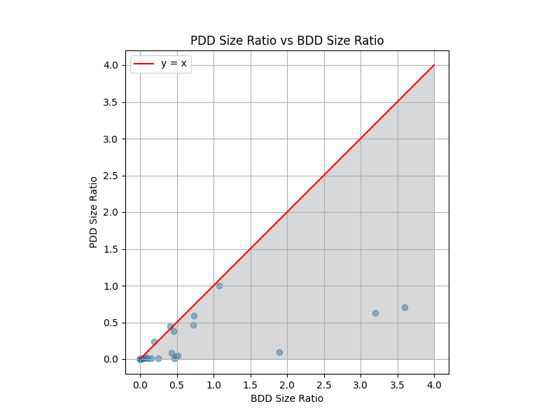
Experimental results
$PDD size ratio=\frac{PDD size}{Number of states}$ $BDD size ratio=\frac{MTBDD size}{Number of states}$

Slide 39
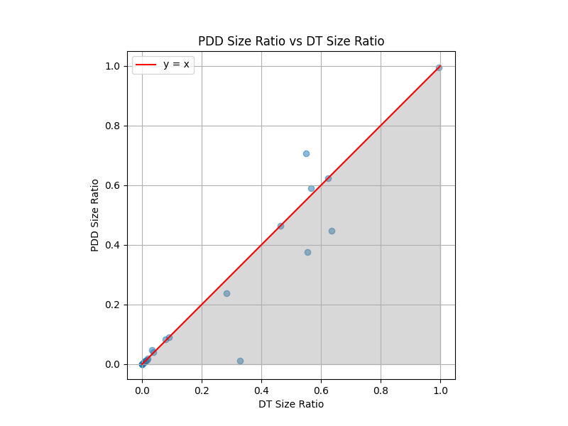
Experimental results
$PDD size ratio=\frac{PDD size}{Number of states}$ $DT size ratio=\frac{DT size}{Number of states}$

Slide 40
Conclusion
Joining the benefits of DTs and MTBDDs seems promising
More explainabilty while maintaining canonicity
Exploit existing tools for size reduction
Already size reductions; even without dedicated PDD learning
Future works: compare different DT learning methods
Future works: dedicated PDD-based synthesis algorithms from controllers

Slide 41
🍎
Questions?

